Slide 1

Lecture #0
Artificial Intelligence
INT404

Slide 2
Course Overview
CSE510, Lovely Professional University, Phagwara
L T P :
Text Book:
“ARTIFICIAL INTELLIGENCE”, RICH, KNIGHT, Mc GRAW HILL , 3rd Edition (2009)
Reference books:
“ARTIFICIAL INTELLIGENCE: A MODERN APPROACH” by STUART RUSSEL, PETER NORVIG, PEARSON, 2nd Edition, (2012)
“Artificial Intelligence with Python “ by PRATEEK JOSHI, PACKT, 1st Edition,(2017)
3 | 1 | 0

Slide 3
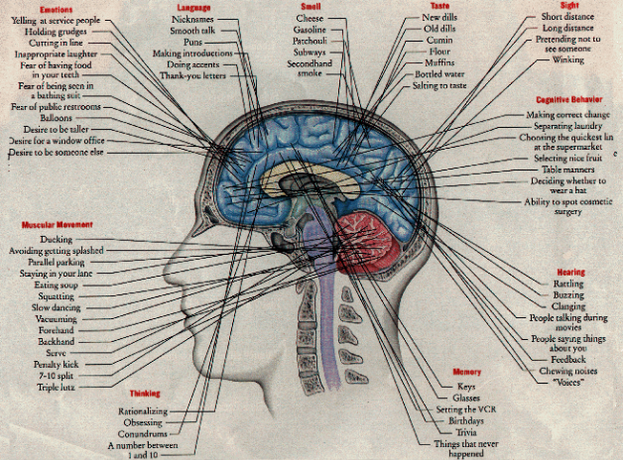
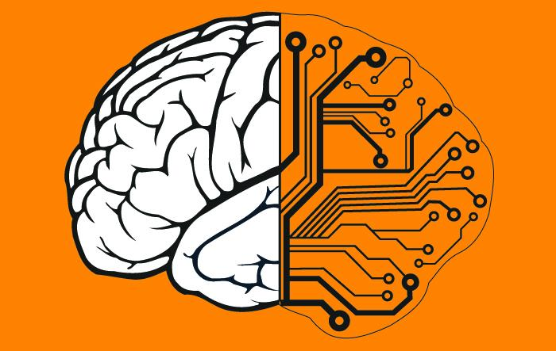
What is AI?
Mapping of Human brain
into machine
Human Brain

Slide 4
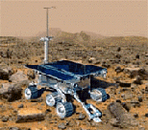

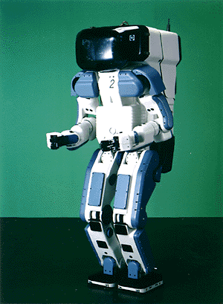

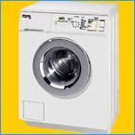
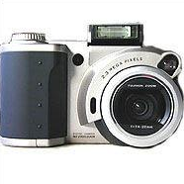
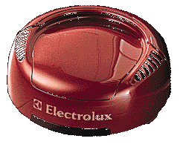
Why study AI?
Search engines
Science
Medicine/
Diagnosis
Labor
Appliances
What else?

Slide 5
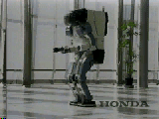
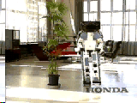
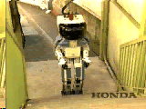
Honda Humanoid Robot
Walk
Turn
Stairs

Slide 6
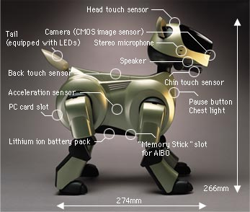
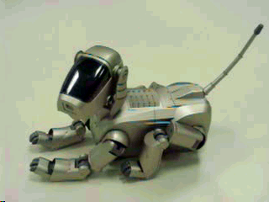
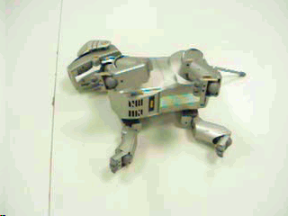
Sony AIBO

Slide 7
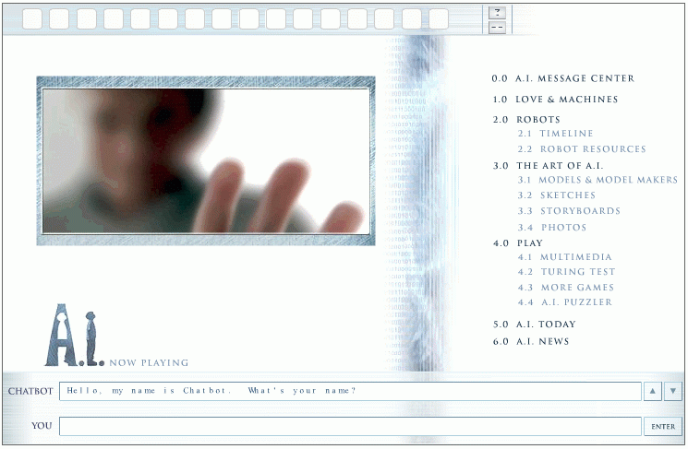
Natural Language Question Answering
http://aimovie.warnerbros.com
http://www.ai.mit.edu/projects/infolab/

Slide 8
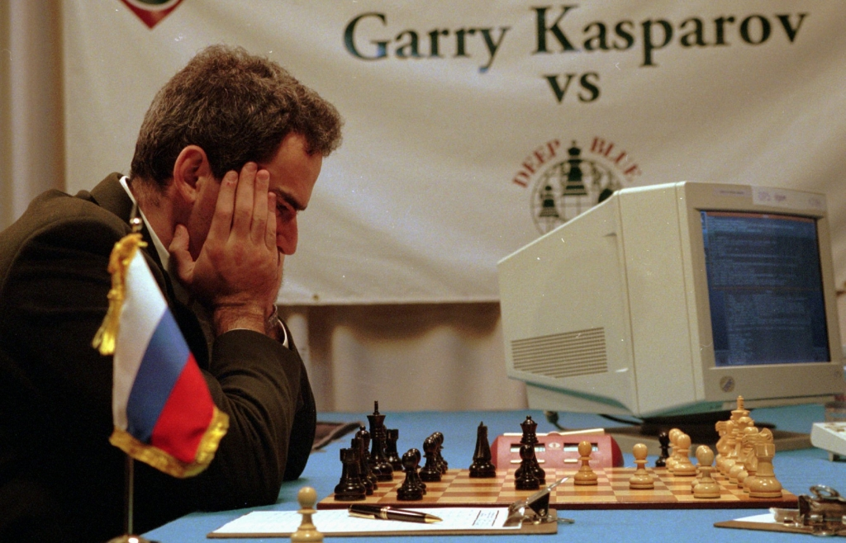
Milestone in the field of Artificial Intelligence

Slide 9
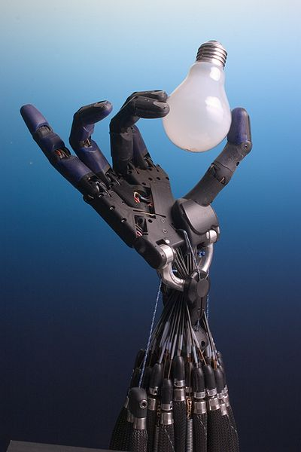
Robot holding electric bulb

Slide 10
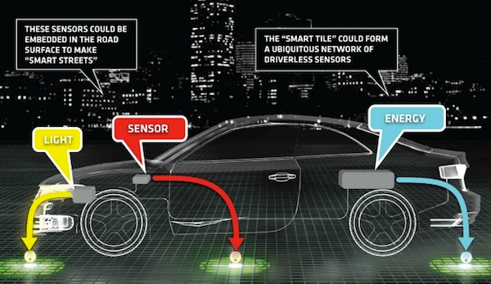
Driver-less Car

Slide 11
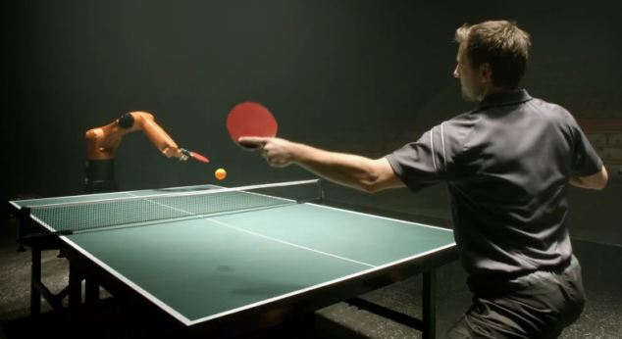
Human vs Robot Table Tennis game

Slide 12
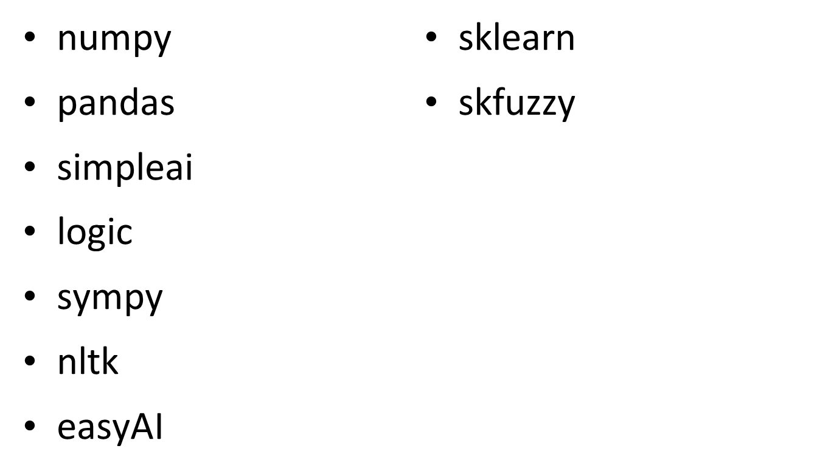
Python Packages Required for AI
12/12/14
CSE510, Lovely Professional University, Phagwara

Slide 13
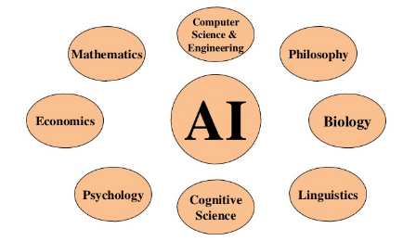
Foundations of AI
Unit 1

Slide 14
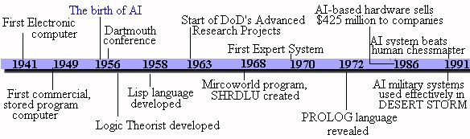
Time-line of AI
Unit 1

Slide 15
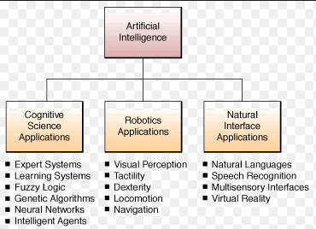
Application areas of AI
Unit 1

Slide 16

CSE510, Lovely Professional University, Phagwara
Thank You !!!

